Slide 1
Big Mountain Resort
A case study

Slide 2
Problem Identification
Implement a better value for the ticket price by
—> Either cut costs without undermining the ticket price
or
—> support an even higher ticket price.

Slide 3
Recommendation and key findings
The dominant top four features in both the models are: fastQuads, Runs, Snow Making_ac and vertical_drop. They have a strong correlation with ticket pricing.
Increase the vertical drop by adding a run to a point 150 feet lower down but requiring the installation of an additional chair lift to bring skiers back up.
Increase ticket price by 1.99 dollars.

Slide 4
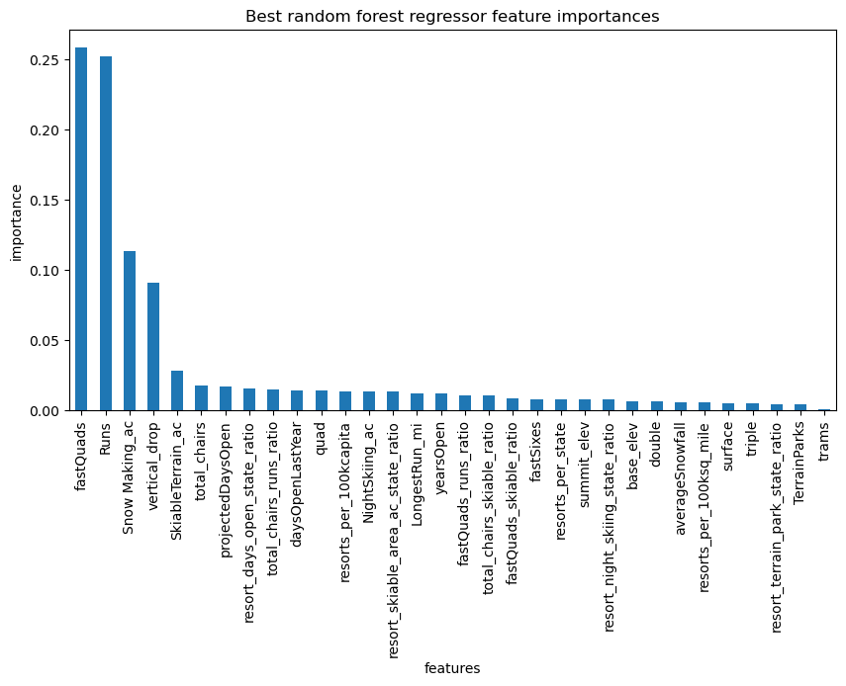
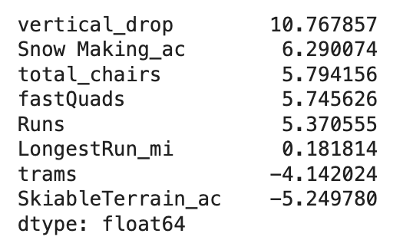
Modeling results and analysis
Table: linear model coefficients showing top 8 features

Slide 5
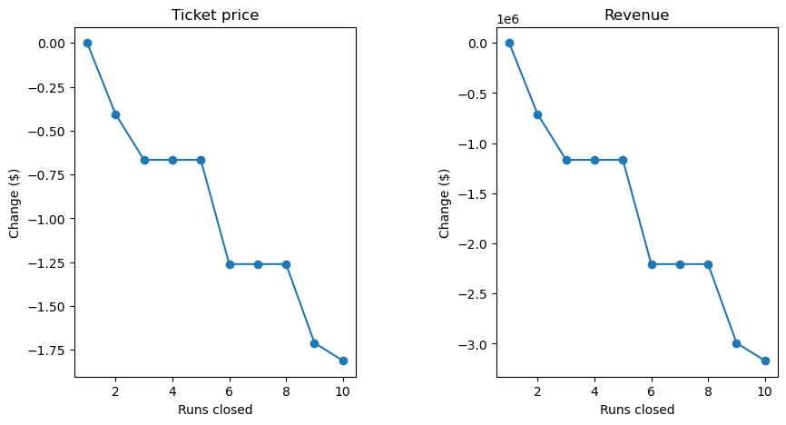
Modeling results and analysis
Four scenarios were modeled.
First Scenario:
Permanently closing down up to 10 of the least used runs.
← Closing one run doesn’t impact ticket price and revenue.

Slide 6
Modeling results and analysis
Second Scenario:
Big Mountain is adding a run, increasing the vertical drop by 150 feet, and installing an additional chair lift.
This scenario increases support for ticket price by $1.99
Over the season, this could be expected to amount to $3474638.

Slide 7
Modeling results and analysis
Third Scenario:
Repeating the Scenario two but adding 2 acres of snow making.
Such a small increase in the snow making area makes no difference!
Fourth Scenario:
Increasing the longest run by .2 miles and guaranteeing its snow coverage by adding 4 acres of snow making capability.
No increase in ticket price with this scenario as well!

Slide 8
Summary and conclusion
Weekend tIcket prices showed strong correlation with fastQuads, Runs, Snow_making_ac and vertical_drop.
Increasing the ticket price by 1.99$ along with addition of a run 150 ft lower down and addition of an extra chairlift will help Big Mountain resort generate high revenue.

